Slide 1

Lecture
on
“CBNST LAB –PMA-402”
by
Akansha Gupta
DEPARTMENT OF COMPUTER SCIENCE AND ENGINEERING
GRAPHIC ERA DEEMED TO BE UNIVERSITY

Slide 2
Regula-Falsi Method

Slide 3
Regula-Falsi Method
Of all the methods to find the root of a function f(x) = 0, the Regula Falsi method is the oldest one. Being a closed bracket method, it is similar in many ways to the bisection method.
Regula falsi method is also known by the name of false position method. Interpolation is the approach of this method to find the root of nonlinear equations by finding new values for successive iterations. In this method, unlike the bisection method, one interval always remains constant.

Slide 4
Features of Regula Falsi Method
No. of initial guesses – 2
Type – closed bracket
Convergence – linear
Rate of convergence – slow
Accuracy – good
Approach – interpolation
Programming effort – easy

Slide 5
Assumptions
Given a function f(x) on floating number x and two numbers ‘a’ and ‘b’ such that f(a)*f(b) < 0 and f(x) is continuous in [a, b]. Here f(x) represents algebraic or transcendental equation. Find root of function in interval [a, b]
Steps:
Write equation of the line connecting the two points.
y – f(a) = ( (f(b)-f(a))/(b-a) )*(x-a)
Now we have to find the point which touches x axis.
For that we put y = 0.
so
x = a - (f(a)/(f(b)-f(a))) * (b-a)
x = (a*f(b) - b*f(a)) / (f(b)-f(a))
This will be our c that is c = x.
If f(c) == 0, then c is the root of the solution.
Else f(c) != 0
If value f(a)*f(c) < 0 then root lies between a and c. So we recur for a and c
Else If f(b)*f(c) < 0 then root lies between b and c. So we recur b and c.
Else given function doesn't follow one of assumptions.

Slide 6
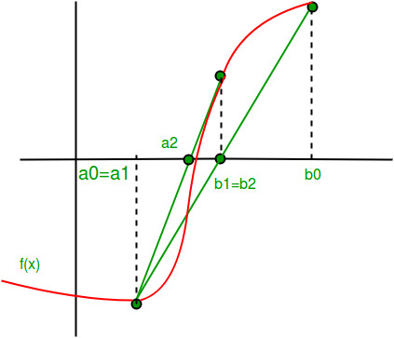
Since root may be a floating point number and may converge very slow in worst case, we iterate for a very large number of times such that the answer becomes closer to the root.
(Or find a value of x such that f(x) is 0).

Slide 7
Regula Falsi Method Algorithm
Start
Read values of x0, x1 and e *Here x0 and x1 are the two initial guesses e is the degree of accuracy or the absolute error i.e. the stopping criteria*
Compute function values f(x0) and f(x1)
Check whether the product of f(x0) and f(x1) is negative or not. If it is positive take another initial guesses. If it is negative then goto step 5.
Determine: x = [x0*f(x1) – x1*f(x0)] / (f(x1) – f(x0))
Check whether the product of f(x1) and f(x) is negative or not. If it is negative, then assign x0 = x; If it is positive, assign x1 = x;
Check whether the value of f(x) is greater than 0.00001 or not. If yes, goto step 5. If no, goto step 8.

Slide 8
Pseudocode for False Position Method
1. Start
2. Define function f(x)
3. Input
a. Lower and Upper guesses x0 and x1
b. tolerable error e
4. If f(x0)*f(x1) > 0
print "Incorrect initial guesses"
goto 3
End If
5. Do
x2 = x0 - ((x0-x1) * f(x0))/(f(x0) - f(x1))
If f(x0)*f(x2) < 0
x1 = x2
Else
x0 = x2
End If
While abs(f(x2) > e
6. Print root as x2
7. Stop

Slide 9
Similarities with Bisection Method
Same Assumptions: This method also assumes that function is continuous in [a, b] and given two numbers 'a' and 'b' are such that f(a) * f(b) < 0.
Always Converges: like Bisection, it always converges, usually considerably faster than Bisection--but sometimes very much more slowly than Bisection.

Slide 10
Differences with Bisection Method
It differs in the fact that we make a chord joining the two points [a, f(a)] and [b, f(b)].

Slide 11
Advantages of Regula Falsi Method
1. It always converges.
2. It does not require the derivative.
3. It is a quick method.

Slide 12
Disadvantages of Regula Falsi Method
1. One of the interval definitions can get stuck.
2. It may slow down in unfavorable situations.

Slide 13
https://youtu.be/80qFA4TVjCM
THANKS

